Slide 1



TEAM- RESONANCE
TEAM MEMBER:-
TUSHAR KUMAR SINGH (LEADER)
AVNI GUPTA
VAIBHAV PURI
ABHISHEK PANDEY
MENTOR: MEETA SINGH (PROFESSOR)
COLLEGE: MANAV RACHNA INTERNATIONAL INSTITUTE OF RESEARCH AND STUDIES

Slide 2


PROBLEM STATEMENT
Design and prototype innovative app or software-based solutions that can detect the use, type, and scale of dark patterns on e-commerce platforms

Slide 3
ABSTRACT
Explore dark patterns in e-commerce, addressing types, applications, and effects.
Utilize advanced detection techniques to uncover and classify misleading design approaches.
Measure frequency and magnitude of dark patterns for a comprehensive understanding.
Create a solution to expose and reduce the impact of dark patterns. Build a foundation to identify and stop dark tendencies, promoting justice and openness.
Contribute to a healthier digital marketplace by enabling stakeholders to foster a reliable, user-focused online commerce environment free from deceptive design techniques.

Slide 4
WHAT ARE WE WORKING ON?
DEVELOP
IMPROVE
EXCELL

Slide 5
SOLUTION

Slide 6
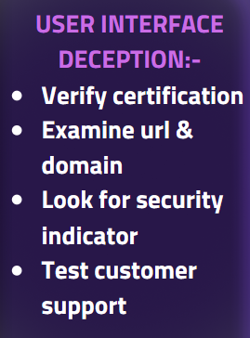
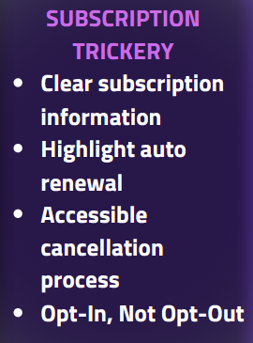
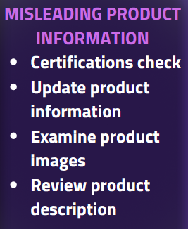
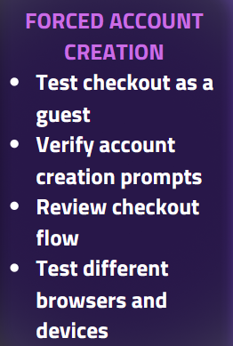
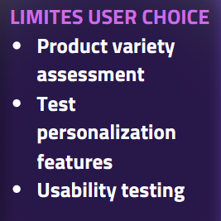
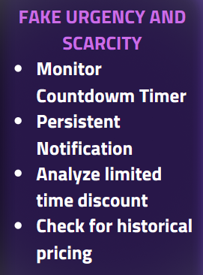
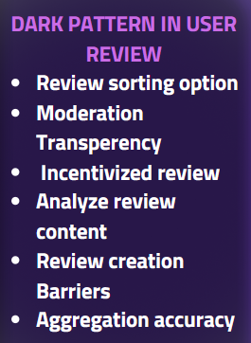
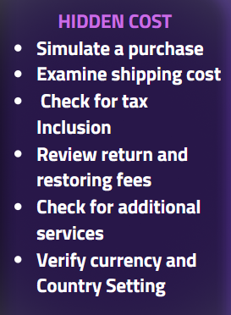

Slide 7


Programming language used
Machine Learning Algorithm
Natural Language Processing
Support vector machine
Python (libraries)
Javascript
Jupyter
Transformers Used for Text Vectorization, Weighting and Normalization
CountVectorizer Bag of Words Transformer
TFIDF(Term Frequency-Inverse Document Frequency) Transformer
Techniques Used for Text Preprocessing
Removing punctuation character
Transforming text to lower case
Eliminating stopwords
Stemming
Lemmatizing
Removing digits
Machine Learning Algorithms Used
Logistic Regression
K Nearest Neighbours
Support Vector Classifier
Decision Tree Classifier
Random Forests Classifier
Multinomial Naive Bayes

Slide 8
PROTOTYPE

Slide 9
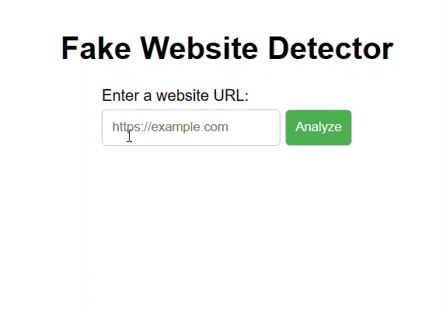
JUST A SMALL CLIP OF OUR WEBSITE THAT WILL CHECK FOR THE WEBSITE ,
PAYMENT METHOD , FAKE REVIEW AND OTHER THINGS ALSO IN ONE GO .

Slide 10
THANKS!

